Slide 1
Waveguides components
Microwave circuits consists of several microwave devices connected in some way to achieve the desired transmission of a microwave signal.
The interconnection of two or more microwave devices may be regarded as a microwave junction.
Waveguide components include:
Waveguide Tees
Hybrid ring
Directional coupler
Isolator, Circulator, Phase shifter
Attenuator
Waveguide Tees (Junction-T)
  Waveguide junctions are used when power in a waveguide needs to be split or some extracted .
  There are a number of different types of waveguide junction that can be use, each type having different properties - the different types of waveguide junction affect the energy contained within the waveguide in different ways.
  A waveguide with 3 independent ports are referred to as tee junction. From S- parameter theory and representation, 3-port tee junction can be represented by (3x3) order matrix.
Characteristic
A short cct. is placed in one of the arms of the tee junction so that no power is transmitted the other junction 2 ports.
It is impossible for general 3 port junction of arbitrary symmetry to represent matched impedance at all port.
If the junction is symmetrical about one of its arms, a short circuit can always be placed in that arm so that no reflections occur in power transmission between the other 2 arms.

Slide 2


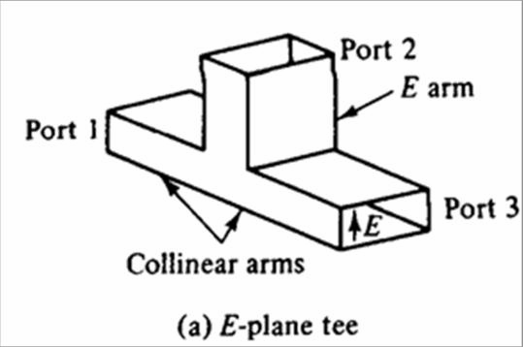
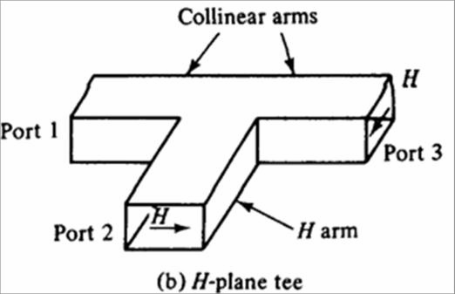


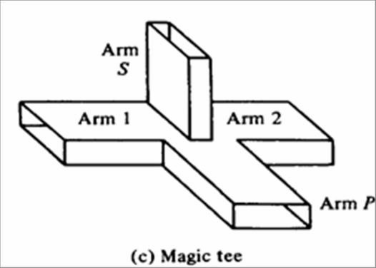
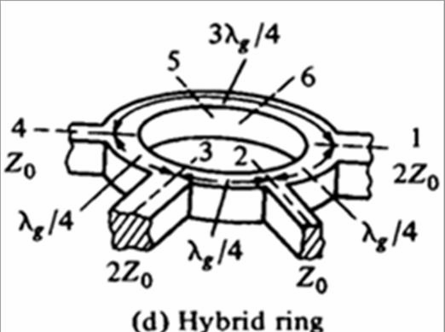
Waveguide Junction Types:
There are a number of different types of waveguide junction. The major types are listed below:
H-type T Junction(Series Tee) : This type of waveguide junction gains its name because top of the "T" in the T junction is parallel to the plane of the magnetic field, H lines in the waveguide .
E-Type T Junction(Shunt tee) : This form of waveguide junction gains its name as an E- type T junction because the top of the "T"
extends from the main waveguide in the same plane as the electric field in the waveguide .
Magic T waveguide junction: The magic T waveguide junction is
effectively a combination of the E-type and H-type waveguide junctions .
Hybrid Ring Waveguide Junction: This form of waveguide junction is another form of waveguide junction that is more
complicated than either the basic E-type or H-type waveguide
junction.

Slide 3

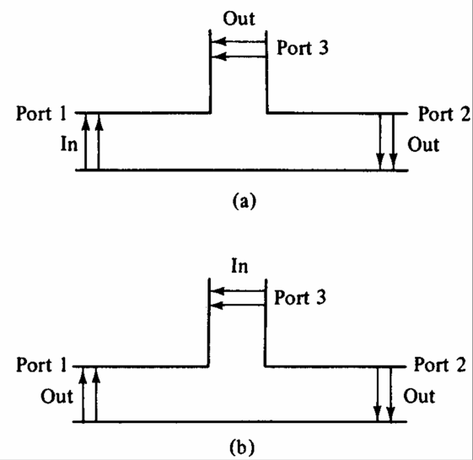
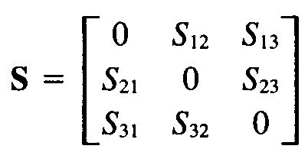
Principle of operation (E-Type T Junction)
If the collinear arms are symmetric about the side arm, there are two different transmission characteristics
Two way Transmission of E-plane tee
i/p-main arm
i/p-side arm
If E-plane tee is perfectly matched with the aid of screw tuners or inductive
or capacitive windows at the junction, the diagonal components of the S-matrix, S₁₁,
S₂₂ and S₃₃ are zero because there will be no reflection.
When the waves are fed into the side arm (port 3), the waves appearing at port1 and port2 of the collinear arm will be in the opposite phase and in the same magnitude. Therefore,
S₁₃ = -S₂₃ (both have opposite signs)
For a matched junction, the S matrix is given by
Symmetry property
S₁₂ = S₂₁, S₁₃ = S₃₁ and S₂₃ = S₃₂

Slide 4

Zero property,
The sum of (each term of any column (row) multiplied by the complex conjugate of the corresponding terms of any column(row) is zero. )
S₁₁S₁₂* + S₂₁S₂₂* + S₃₁S₃₂* = 0
Hence,
S₁₃S₂₃* = 0
i.e S₁₃ = 0 or S₂₃ = 0 or both = 0 Unity property,
The sum of the products of each term of any one row (column) multiplied by its complex conjugate is unity
S₂₁S₂₁* + S₃₁S₃₁* = 1 S₁₂S₁₂* + S₃₂S₃₂* = 1 S₁₃S₁₃* + S₂₃S₂₃* = 1
I II
III
Sub st zero property in unitary property
IV
Eq III and IV are contradictory
If S₁₃ = 0 then S₂₃ = 0 and thus eqn III is false.
Similarly, if S₂₃ = 0, then S₁₃ = 0 and hence eq IV is also not true.

Slide 5


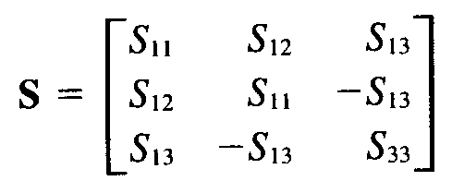
This inconsistency proves the statement that the tee junction cannot be matched to the three arms.
Diagonal elements are not all zero
When an E-plane is constructed of an empty waveguide, it is poorly matched at the tee junction.
Hence
However since the collinear arm is usually symmetric about the side arm,
Thus,
Principle of operation (H-Type T Junction)
If two input waves are fed into port 1 and port 2 of the collinear arm, the output wave at port 3 will be in phase and additive.
If the input is fed into port 3, the wave will split equally into port 1 and port 2 in phase and in the same magnitude.
Therefore the S matrix of H-plane tee is similar to E-plane tee except S13 = S23
Principle of operation (Magic Tees (Hybrid Tee))
If two waves of equal magnitude and the same phase are fed into port 1 and port 2, the output will be zero at port 3 and additive at port 4.
If a wave is fed into port 4 (H arm), it will be divided equally between port 1 and port 2 of the collinear arms and will not appear
at port 3 (E arm(.

Slide 6
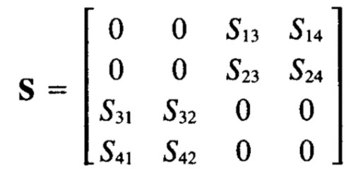
If a wave is fed into port 3 (E arm), it will produce an output of equal magnitude and opposite phase at port 1 and port 2. Output at port 4 is zero i.e S₄₃ = S₃₄ = 0
4. If a wave is fed into one of the collinear arms at port 1 or port 2, it will not appear in the other collinear arm at port 2 or port 1 because the E arm causes a phase delay while the H arm causes the
phase advance. i.e S₁₂ = S₂₁ = 0.
S matrix of magic tee is
Directional Coupler
  A directional coupler is a passive device that divided and distributes power, which couples part of the transmission power by a known amount out through another port, often by using two transmission lines set close enough together such that energy passing through one is coupled to the other.
  The device has four ports: input, transmitted, coupled, and isolated.
The term "main line" refers to the section between ports 1 and 2.
  Common properties desired for all directional couplers are wide operational bandwidth, high directivity, and a good impedance match at all ports when the other ports are terminated in matched loads.

Slide 7

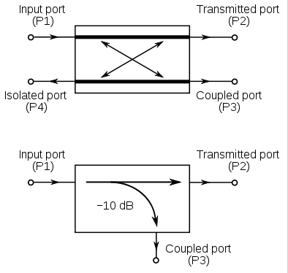
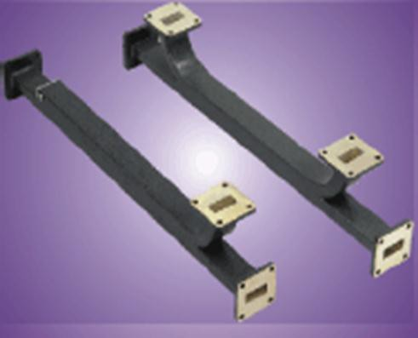

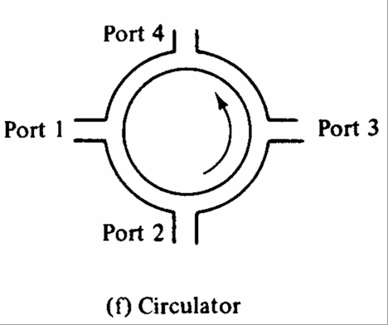

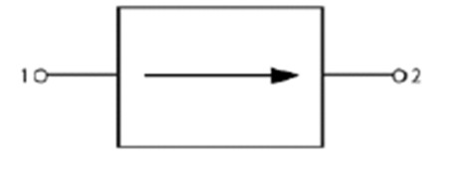


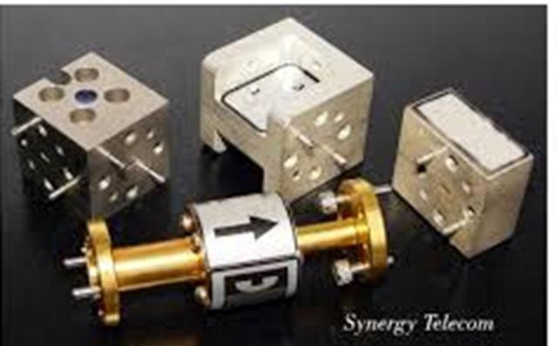
3-Circulator and Isolator
Both use the unique properties of ferrites in a magnetic field
The ideal circulator is lossless, matched at all ports, but not reciprocal.
A signal entering the ideal circulator at one port is transmitted exclusively to the next port in the sense of the arrow
Isolator passes signals in one direction, attenuates in the other
Circulator passes input from each port to the next around the circle, not to any other port
Isolator

Slide 8
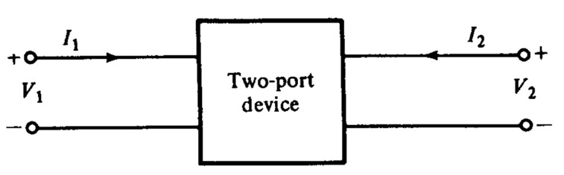
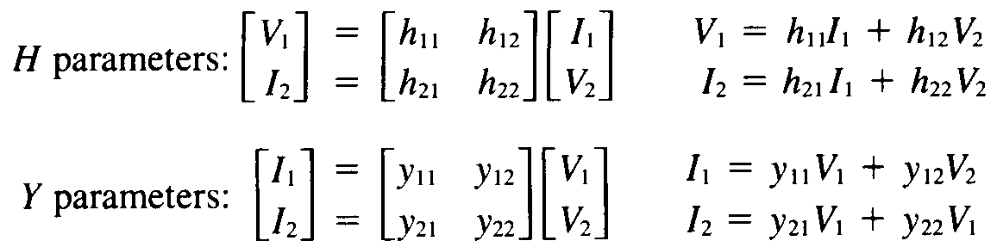
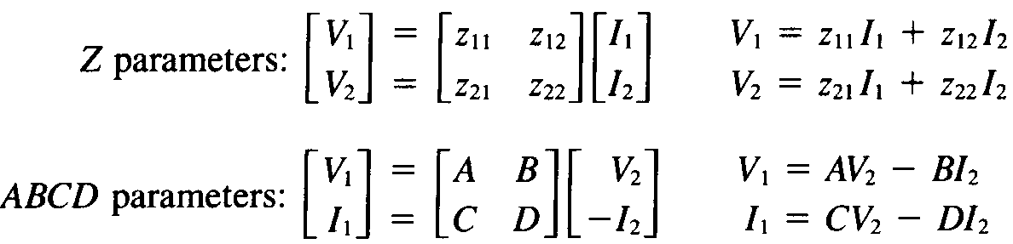
4- Mixers
The mixer takes two signals and combines them creating new signals. It can be used to translate microwave signals into much lower frequencies that an inexpensive radio receiver can tune. It can even reverse the effect taking low frequencies and translating them back into the microwave range.
Mixers are needed in most microwave systems because the RF signal is way too high to process its information (for example,
looking for a Doppler shift in an X-band radar application, you
won't find many A/D converters than can handle 10 GHz !)
Scattering Matrix
Two Port Network

Slide 9
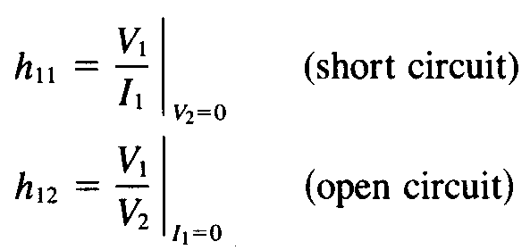
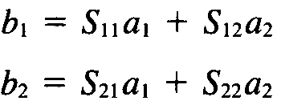
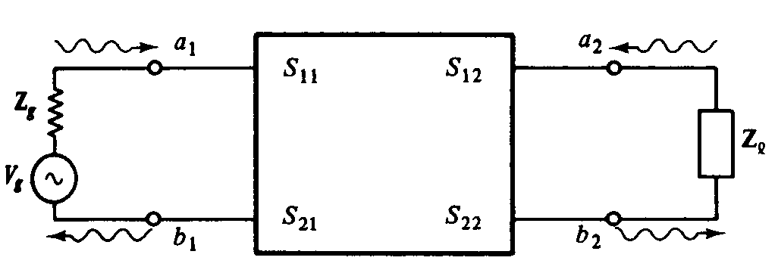
All these network parameters relate total voltages and total currents at each of the two ports. For Ex.:
If the frequencies are in the microwave range, however……………….., The H,Y and Z parameters cannot be measured for the following reasons
Equipment is not readily available to measure total voltage and total current at the ports of the network.
Short and Open circuits are difficult to achieve over a broad band of frequencies.
Active devices, such as power transistors and tunnel diodes, frequently will not have stability for a short or open circuit.
New method of characterization is needed. The logical variables to use at the microwave frequencies are travelling waves rather than total voltages and total currents .These are the S parameters,
S parameters of a two port network
Input reflection coefficient with output port matched
a2=0

Slide 10





a1=0
Reverse transmission coefficient with input port matched
Output reflection coefficient with input port matched
a2=0
a1=0
Forward transmission coefficient with output port matched
Chain Scattering Parameters
Also called scatting transfer parameters.
a₁, b₁ a₂, b₂
dependent variables
independent variables
a₁ = T₁₁b₂+T₁₂a₂ b₁ = T₂₁b₂+T₂₂ a₂
a₁ =
b₁ =
T11 T12
T21 T22
b₂ a₂
Relation between [S] and [T] b₁=S₁₁a₁+S₁₂a₂ b₂=S₂₁a₁+S₂₂a₂
a₁=T₁₁b₂+T₁₂a₂ b₁=T₂₁b₂+T₂₂a₂
……….(1)
a2=0
For b2=0,
b2=0
S₂₂a₂= -S₂₁a₁
………..(2)

Slide 11
a2=0
………….(3)
b2=0
From (2)
a₁=
a₂ , b₁=S₁₁
a₂+ S₁₂ a₂
(
₎
[
]
Similarly it can be shown that
( ) [
]
T – parameters are used when the networks are to be cascaded.

